Slide 1

Facilities Update
Presented to:
Garden Grove Unified School District
Bond Oversight Committee
May 9th, 2017
Presenters: Margie Brown and Kevin Heerschap

Slide 2
Modernization & HVAC
Modernization and HVAC
Elementary: Stanley
Intermediate: Fitz, Irvine, Lake & Ralston
High: Bolsa Grande, Garden Grove,
Los Amigos & Santiago
May 9, 2017

Slide 3
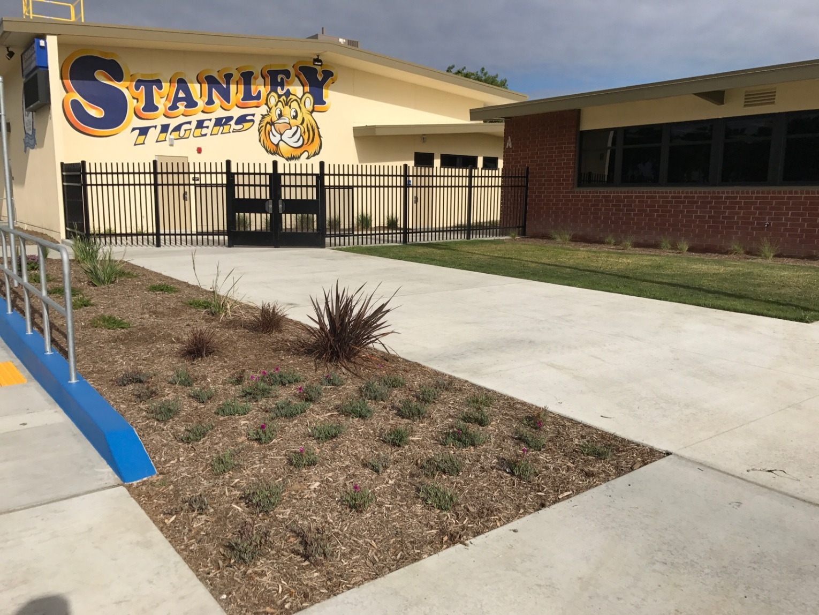
Modernization & HVAC
Stanley ES
May 9, 2017
New accessible concrete entry

Slide 4
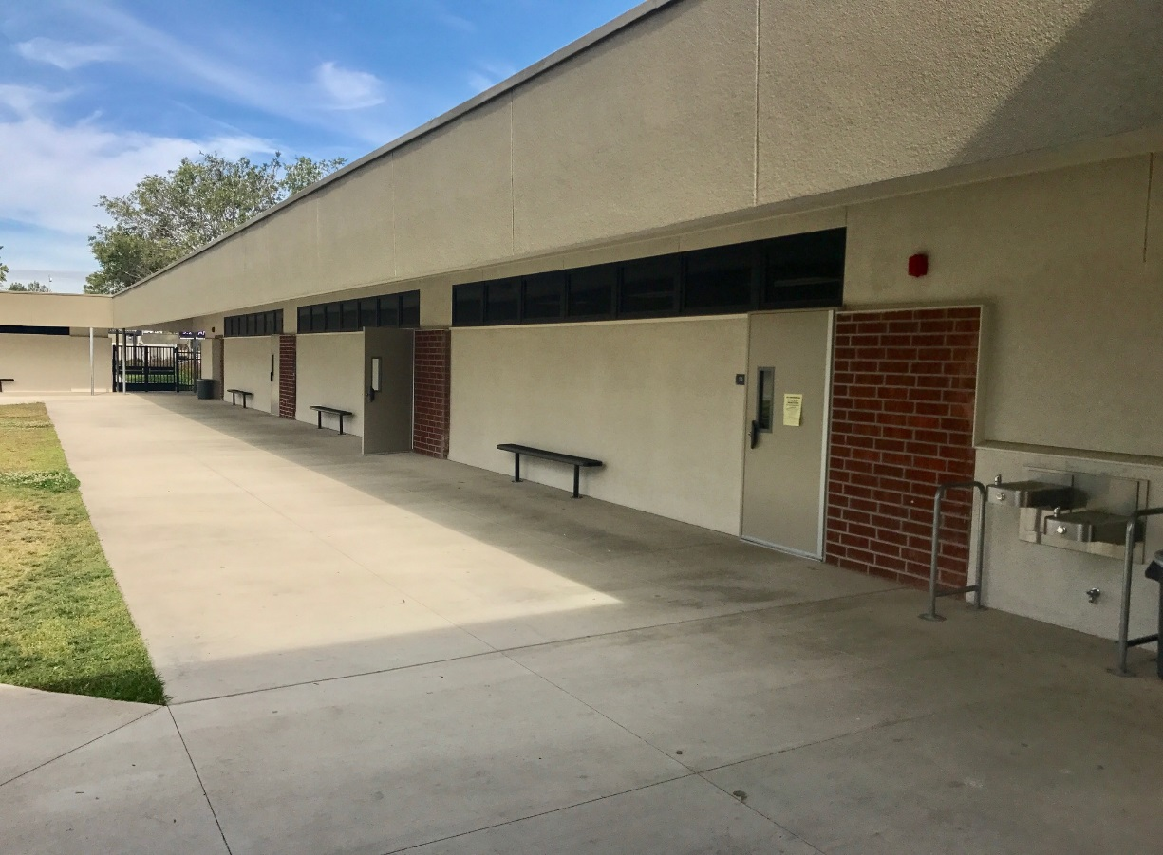
Modernization & HVAC
Fitz IS
May 9, 2017
Window infill and new upper windows

Slide 5
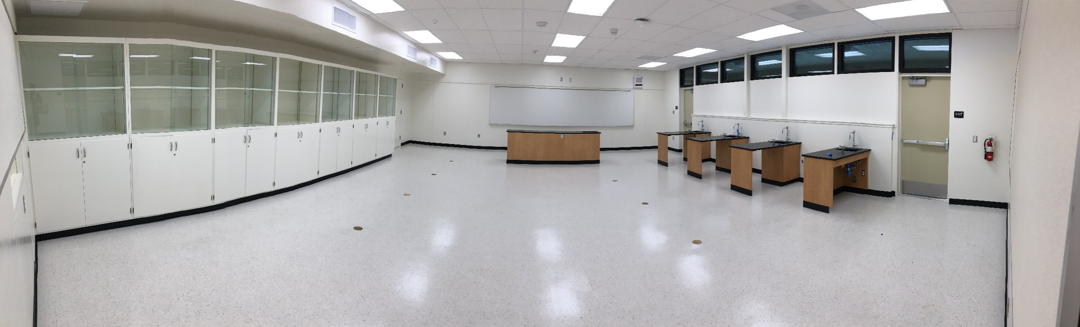
Modernization & HVAC
Irvine IS
May 9, 2017
New Science rooms

Slide 6
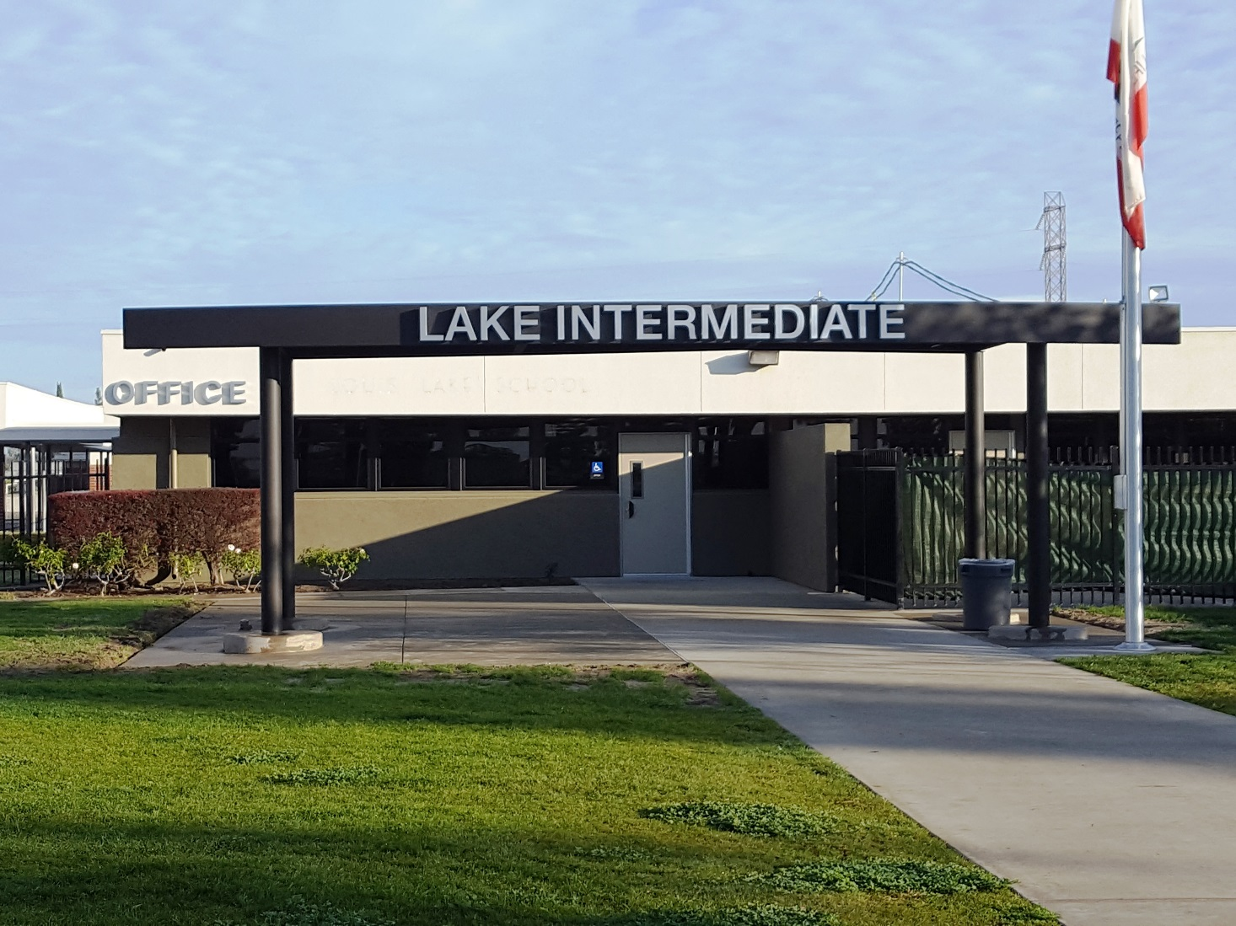
Modernization & HVAC
Lake IS
May 9, 2017
New office entry

Slide 7
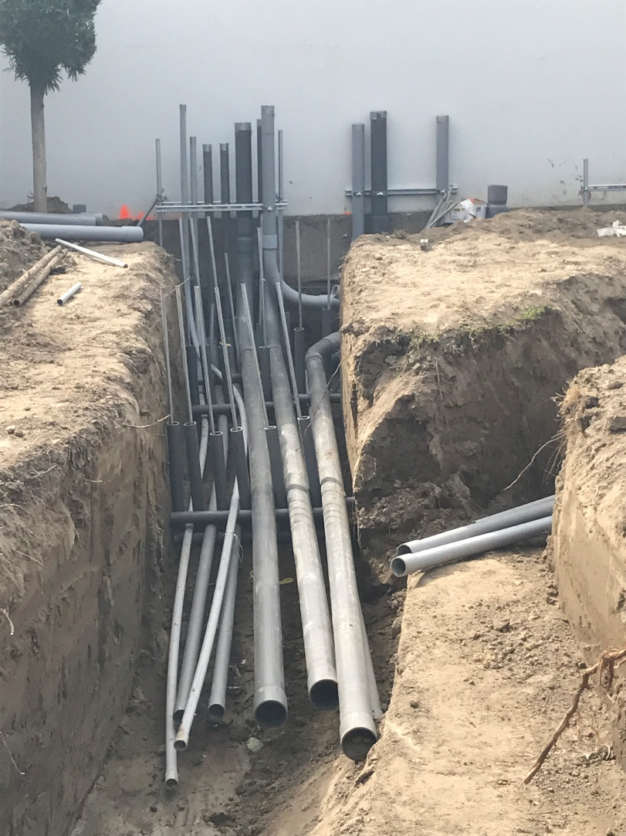
Modernization & HVAC
Ralston IS
May 9, 2017
Trenching for new underground utilities

Slide 8
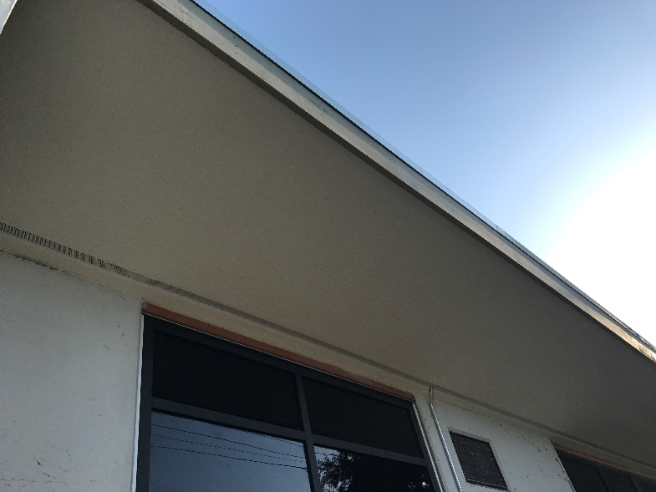
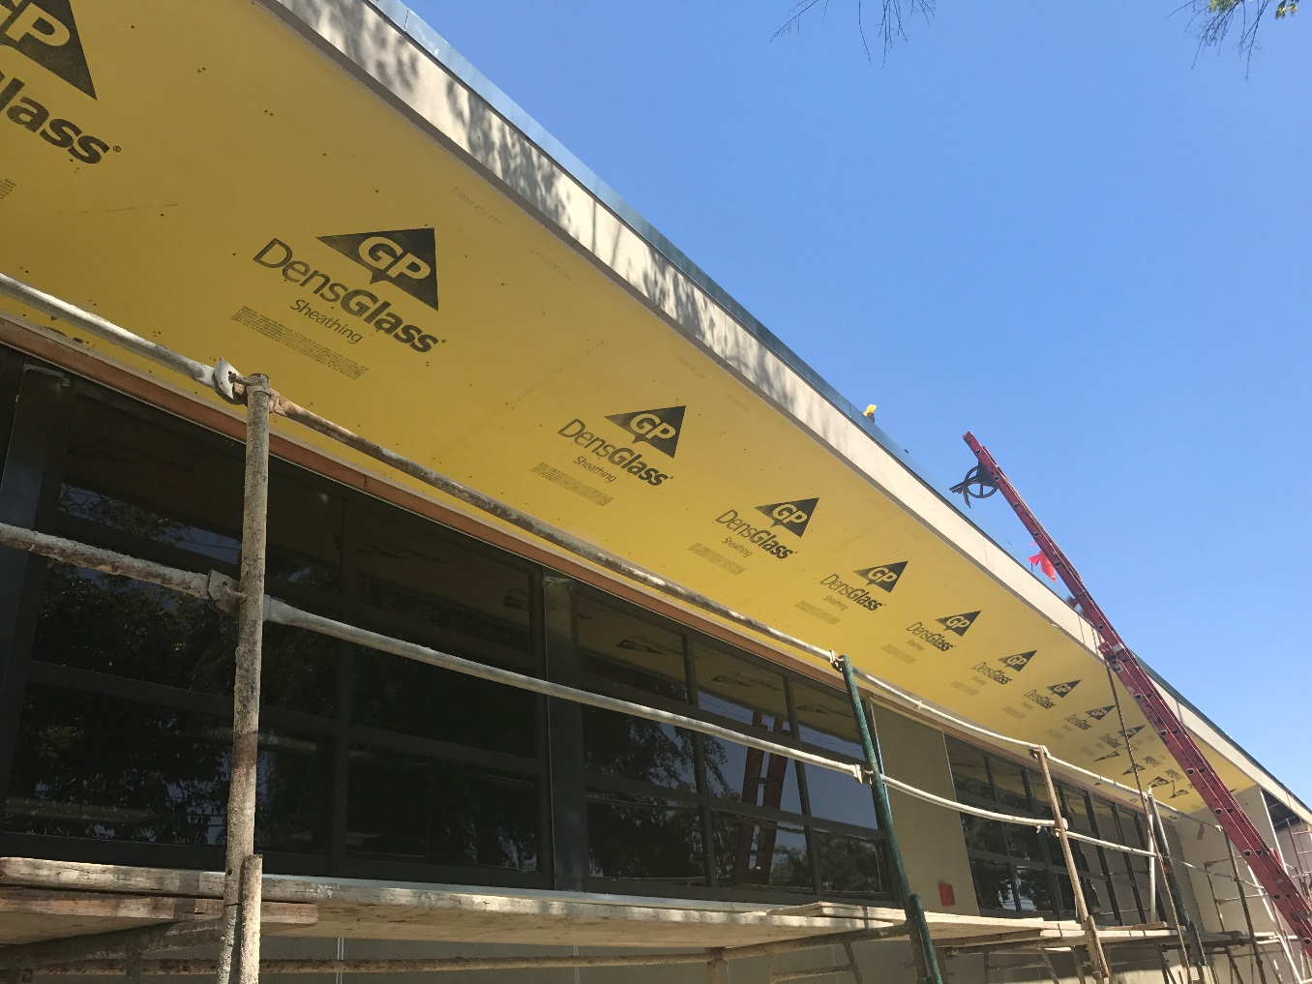
Modernization & HVAC
Ralston IS
May 9, 2017
New windows, and Canopy repair

Slide 9
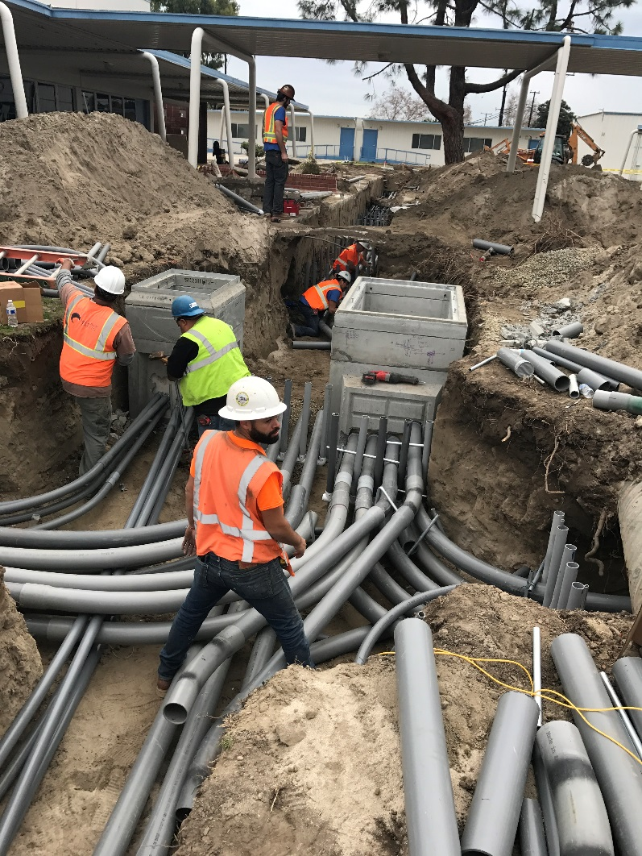
Modernization & HVAC
Bolsa Grande HS
May 9, 2017
Underground conduit installation

Slide 10
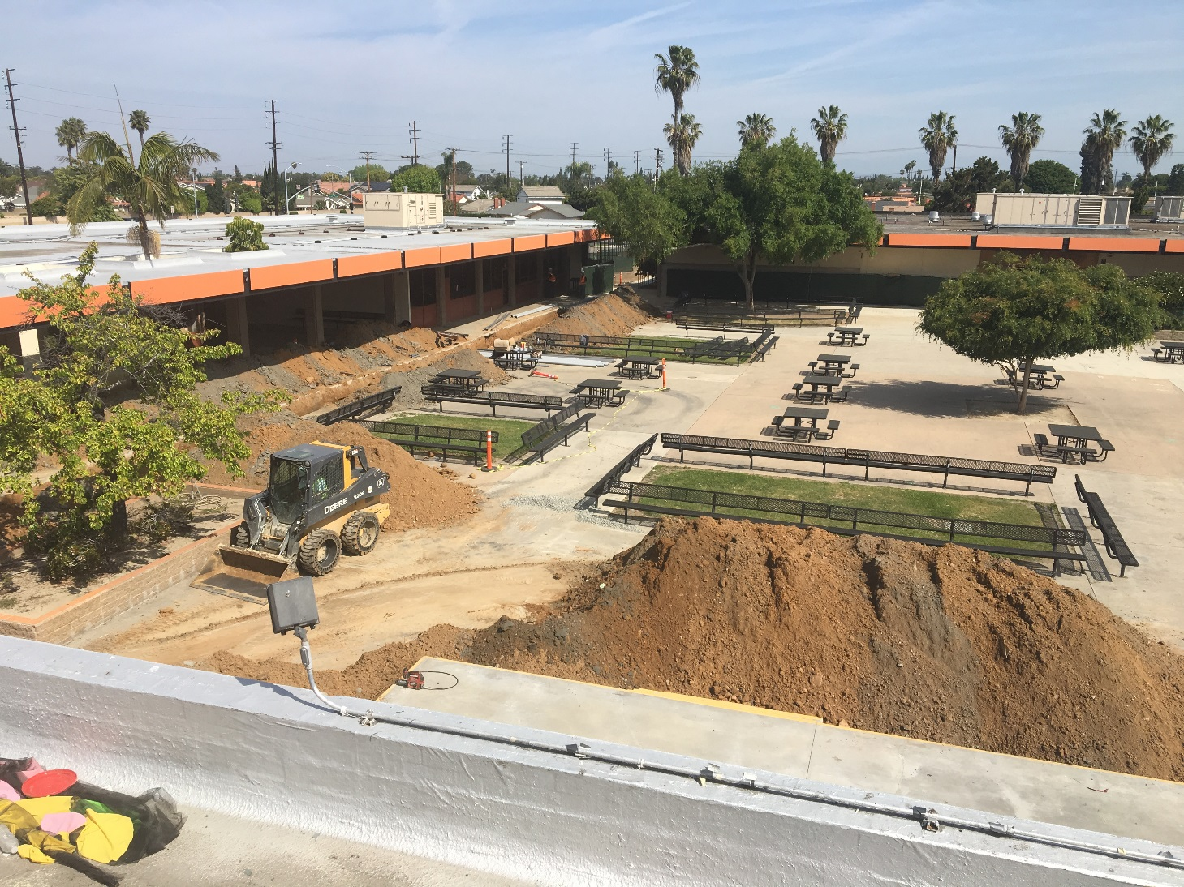
Modernization & HVAC
Los Amigos HS
May 9, 2017
New electrical and low voltage pathways

Slide 11
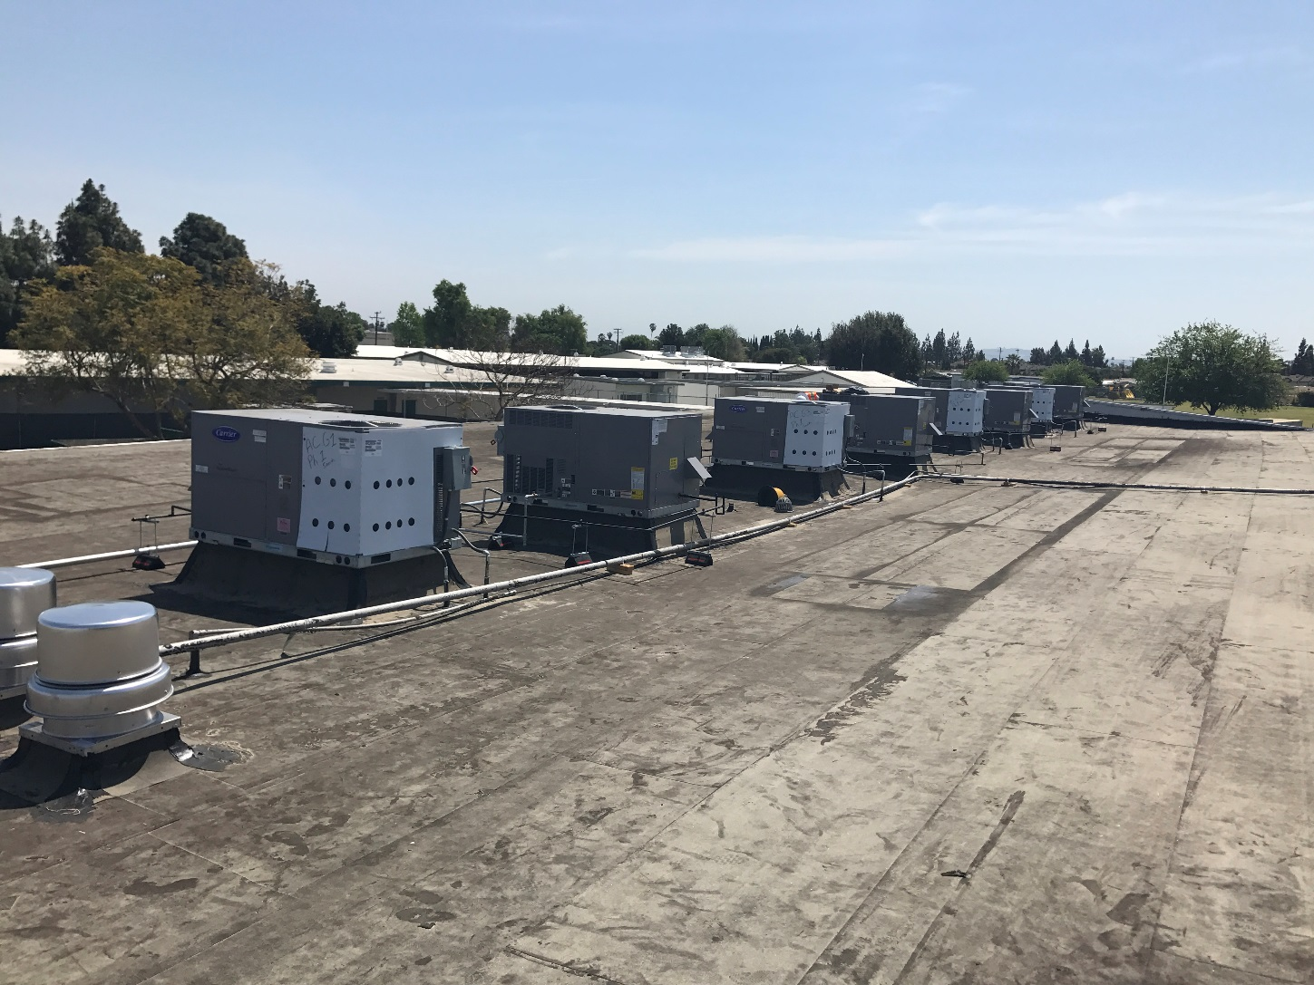
Modernization & HVAC
Santiago HS
May 9, 2017
New HVAC and roofing

Slide 12
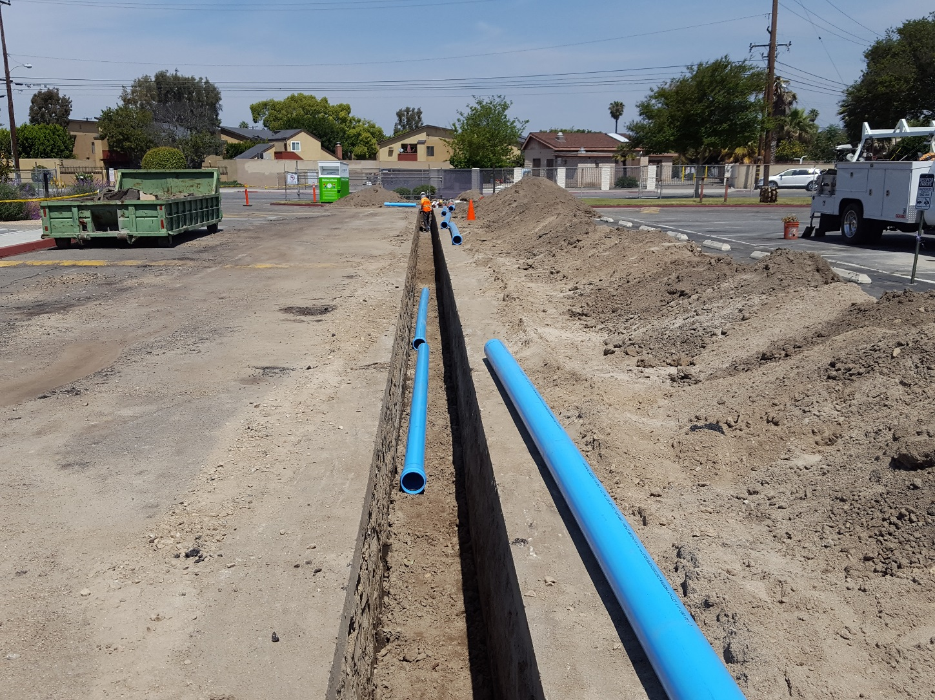
Modernization & HVAC
Santiago HS
May 9, 2017
New Water service

Slide 13
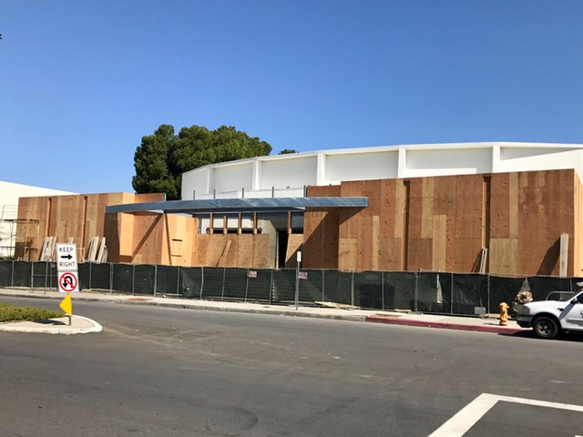
Modernization & HVAC
Garden Grove HS
May 9, 2017
Don Wash Auditorium

Slide 14
Seismic Projects
La Quinta & Pacifica High Schools
Stadium Upgrades
GGHS
Upcoming HVAC 2017
Hazard, Heritage, Rosita,
Wakeham & Zeyen Elementary Schools
Projects in planning
May 9, 2017

Slide 15
LA QUINTA/PACIFICA HIGH SCHOOL
NEW CONSTRUCTION
LA QUINTA HS Replacement Buildings Phase 1 CR Construction – Summer 2016 Move In / Exis. Building Demo – Summer 2017
Phase 2 CR & Cafeteria Const. – Winter 2017 Move In / Exis. Building Demo – Winter 2018 Theatre & Library Media – Winter 2018 Completion – Fall 2019
May 9, 2017

Slide 16
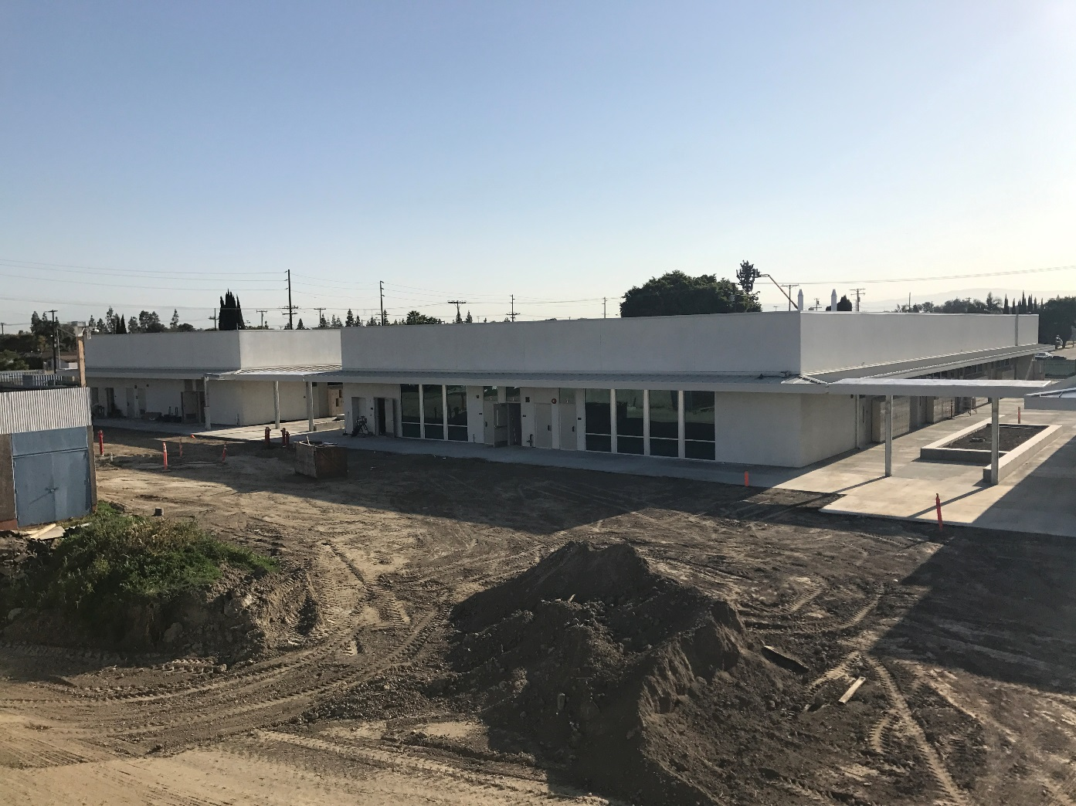
Seismic Replacement
La Quinta HS
May 9, 2017
New Buildings

Slide 17
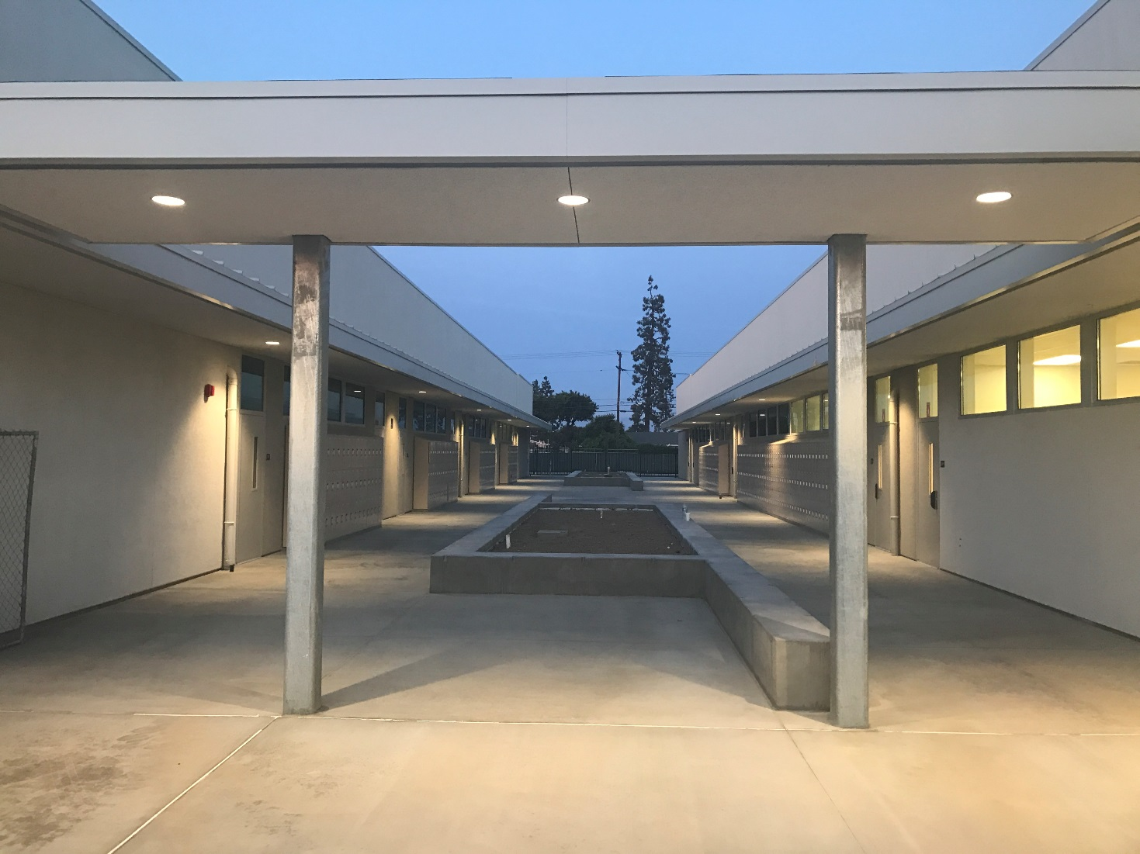
Seismic Replacement
La Quinta HS
May 9, 2017
New seat walls, lighting, and lockers

Slide 18
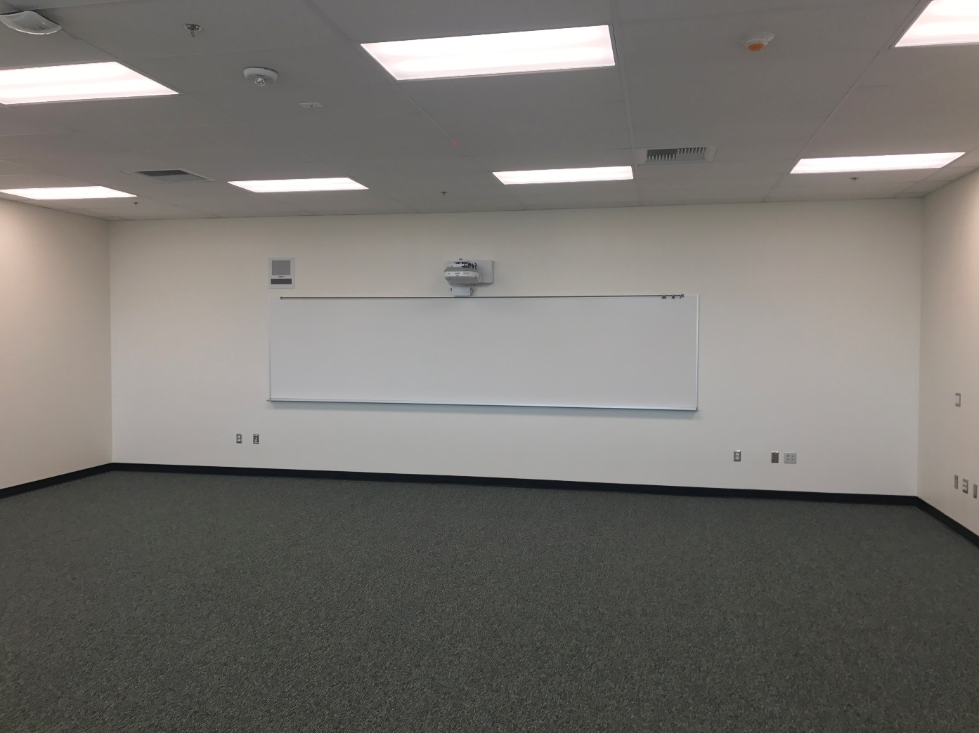
Seismic Replacement
La Quinta HS
May 9, 2017
Typical classroom interior

Slide 19
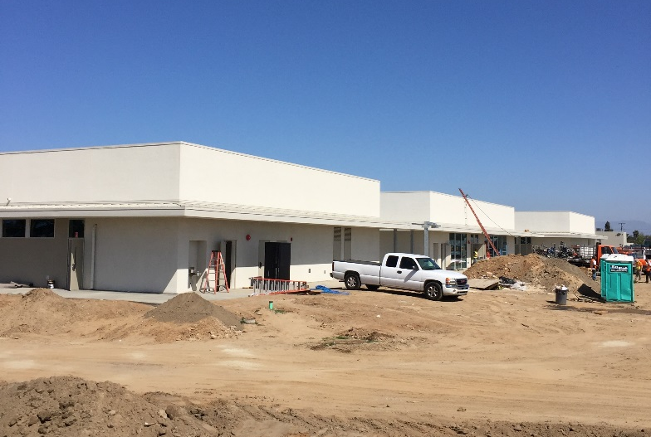
Seismic Replacement
Pacifica HS
New Building color matched Stucco
@ Replacement Building
May 9, 2017

Slide 20
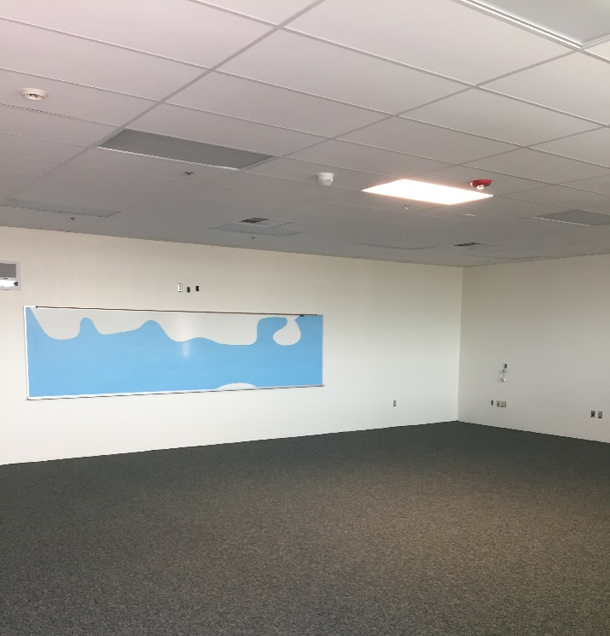
Seismic Replacement
Pacifica HS
Typical Classroom
May 9, 2017

Slide 21
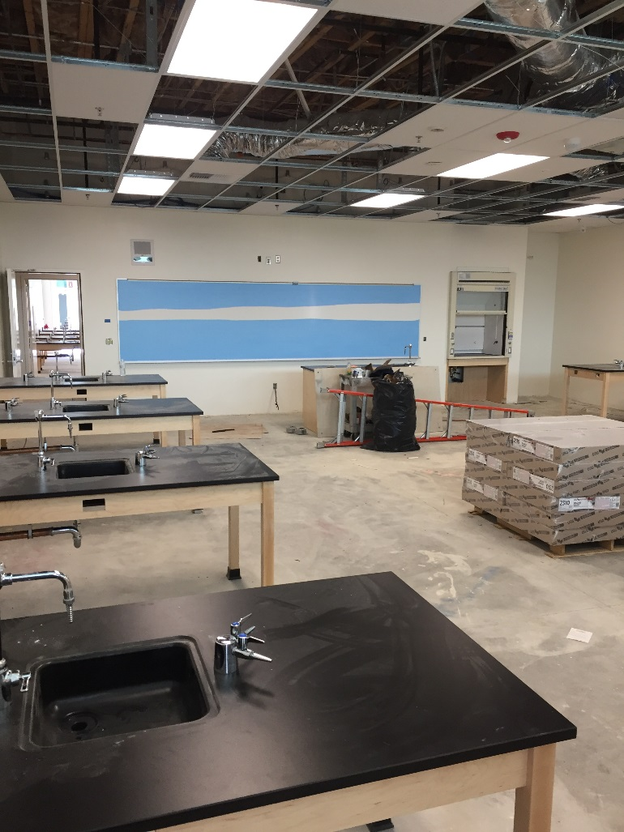
Seismic Replacement
Pacifica HS
May 9, 2017
New Science Classroom

Slide 22
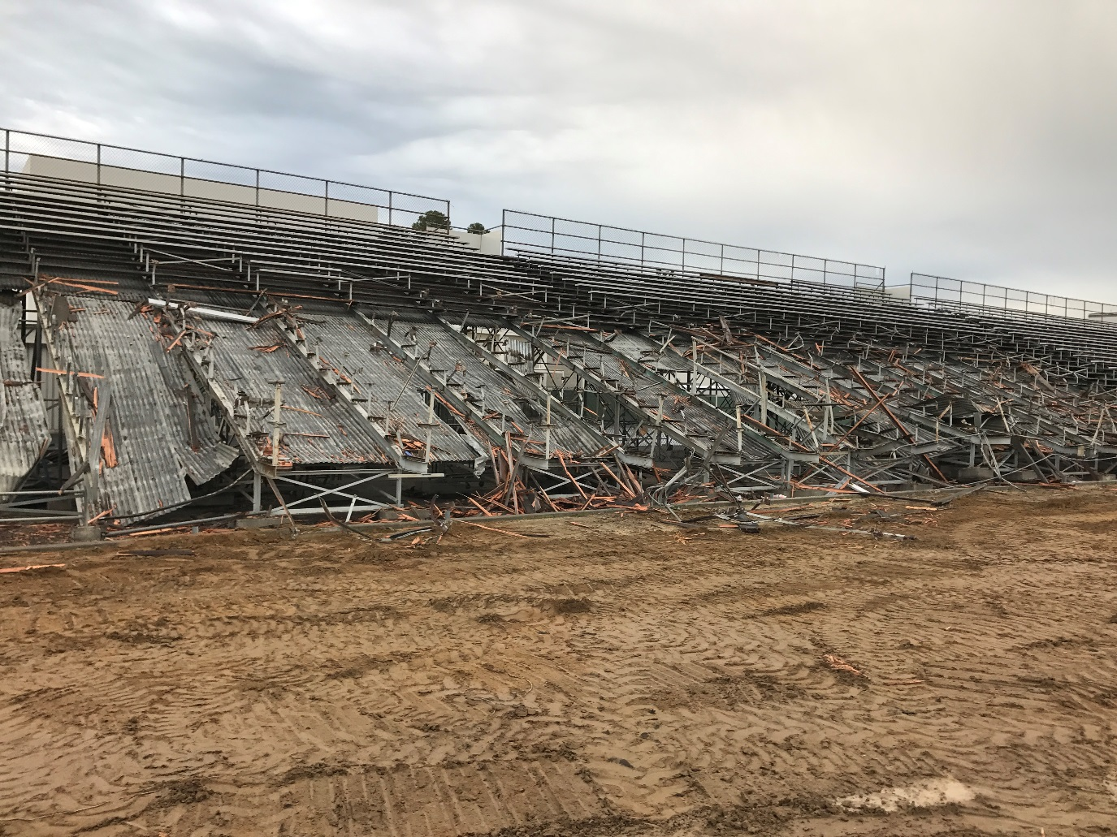
Monsoor Stadium
Garden Grove HS
May 9, 2017
Out with the old

Slide 23
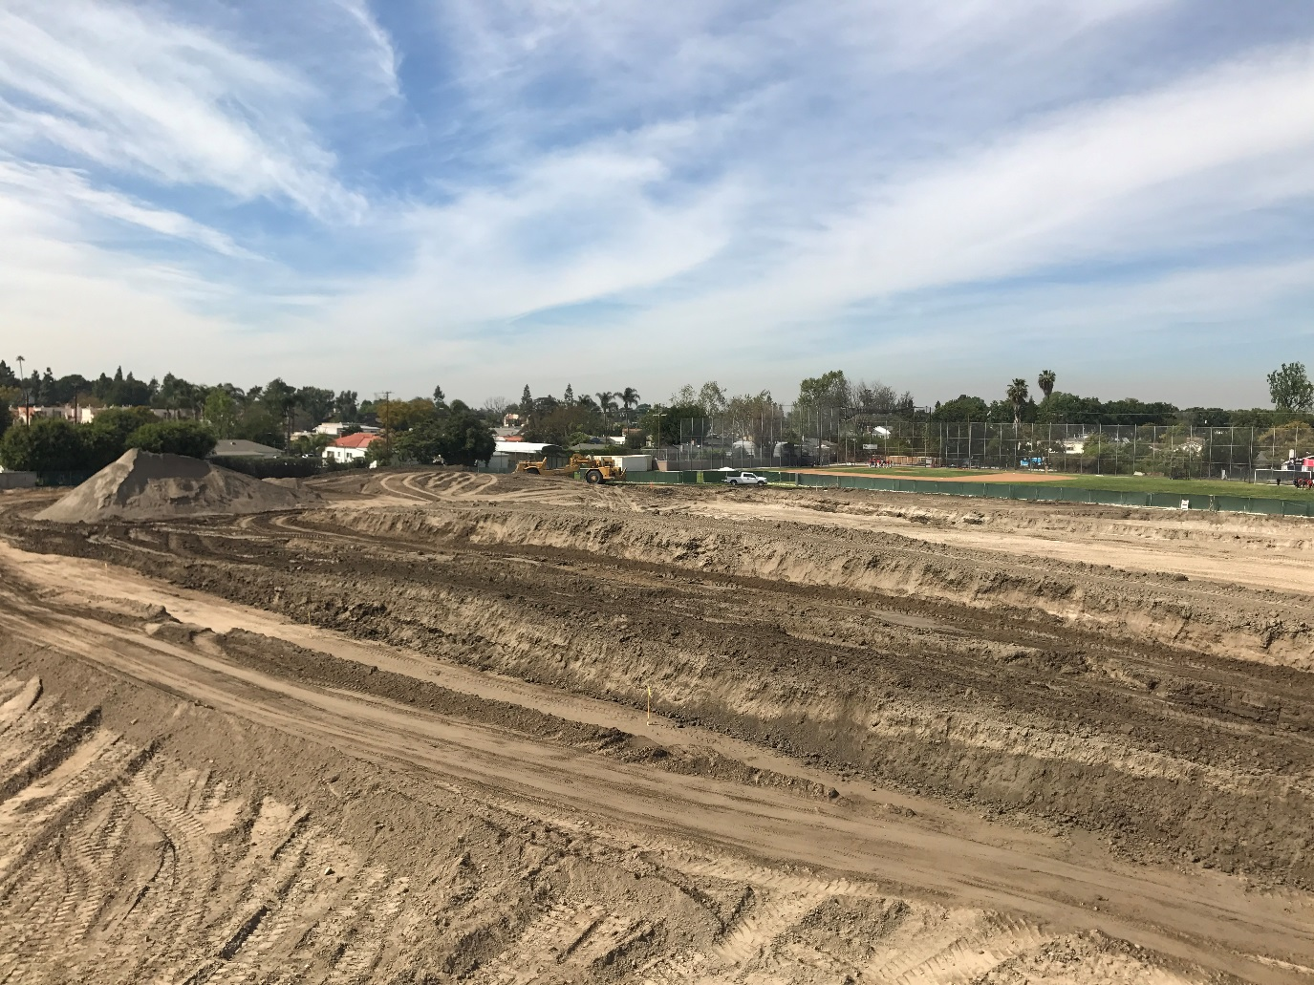
Monsoor Stadium
Garden Grove HS
May 9, 2017
Grading Begins

Slide 24
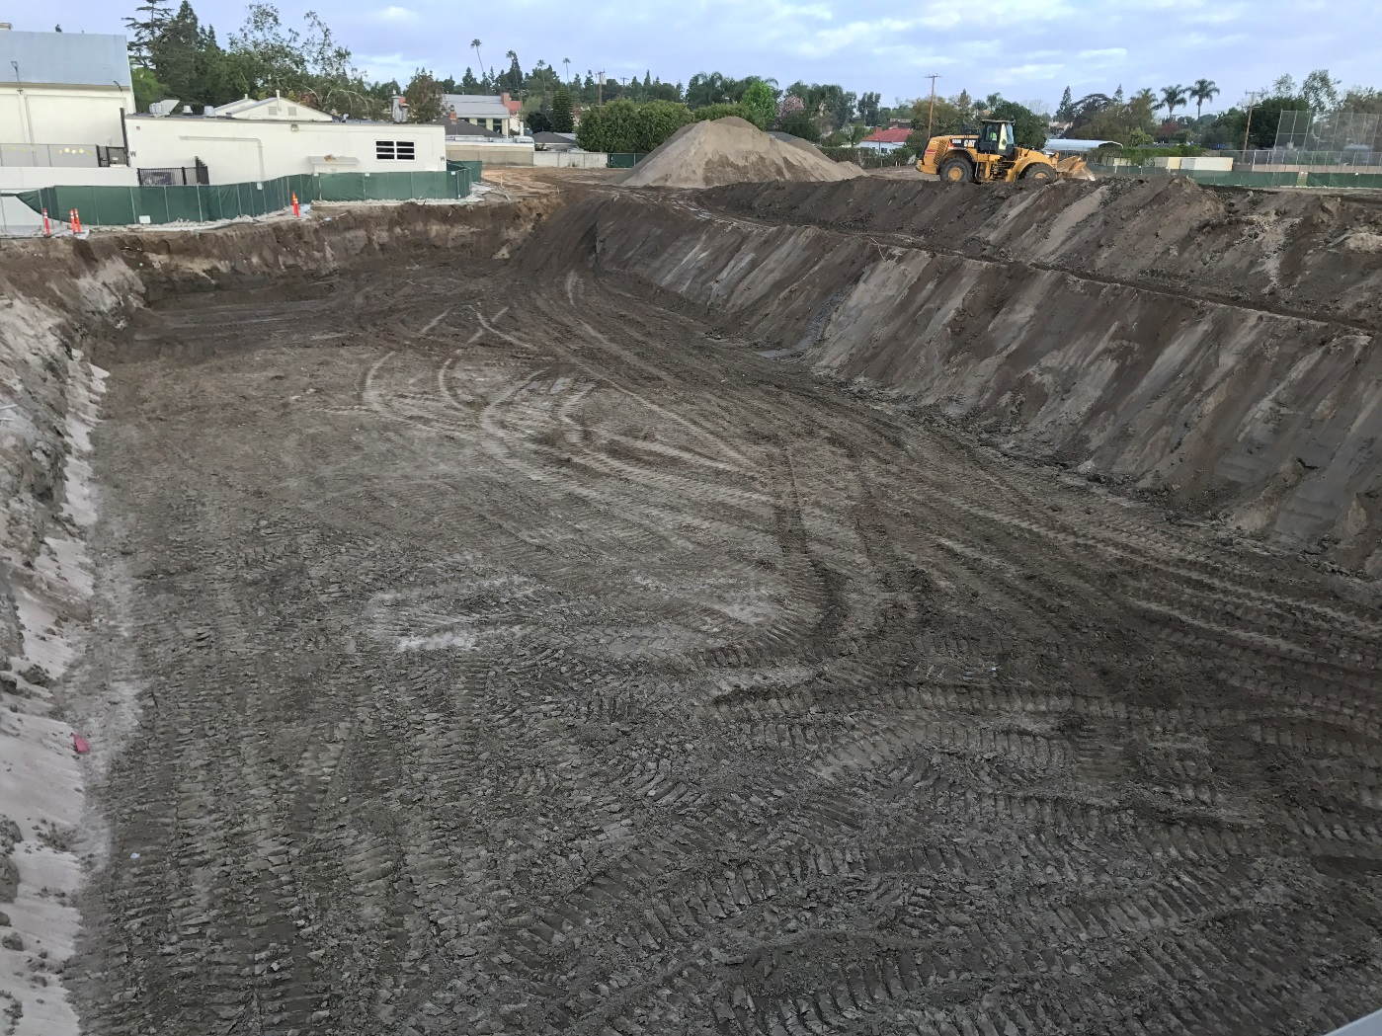
Monsoor Stadium
Garden Grove HS
May 9, 2017
Over excavation for Bleacher pads

Slide 25
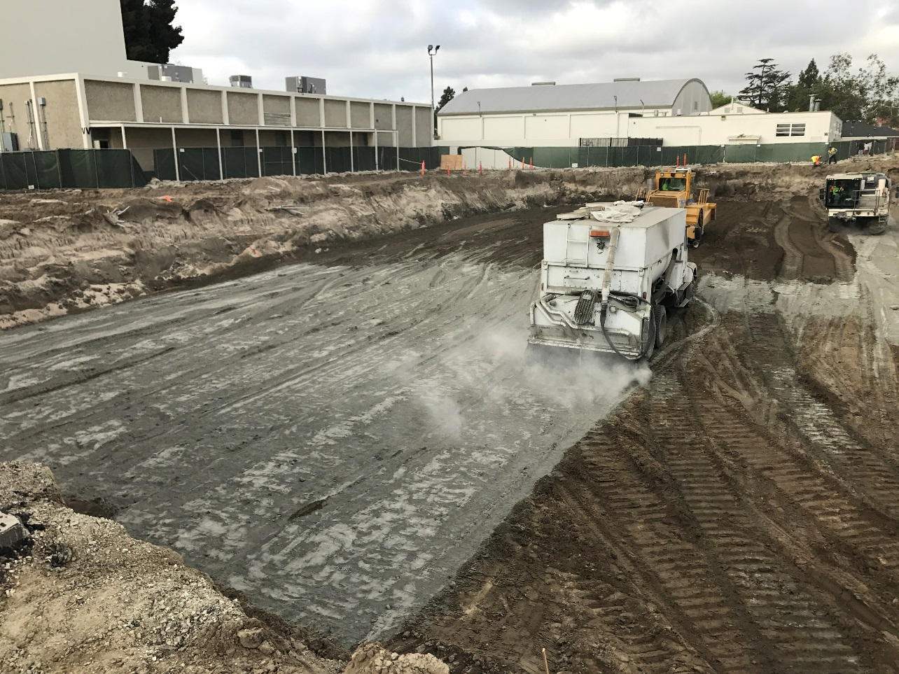
Monsoor Stadium
Garden Grove HS
May 9, 2017
Cement soil treatment

Slide 26
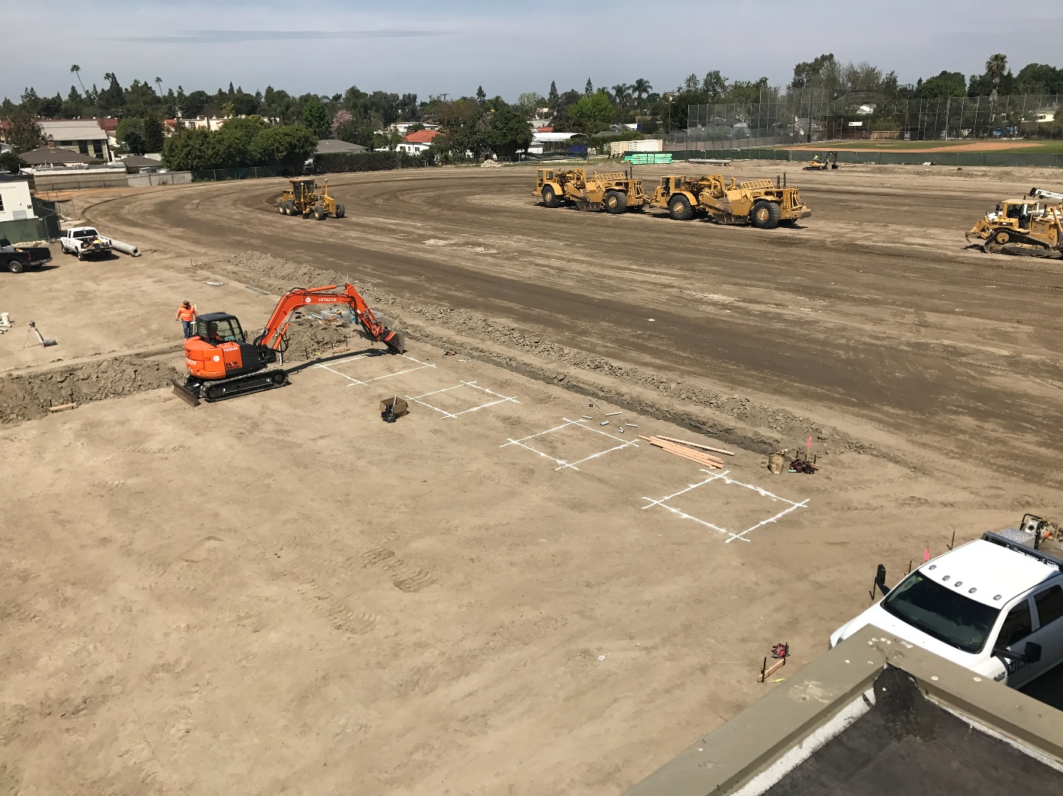
Monsoor Stadium
Garden Grove HS
May 9, 2017
Finish grading and utilities

Slide 27
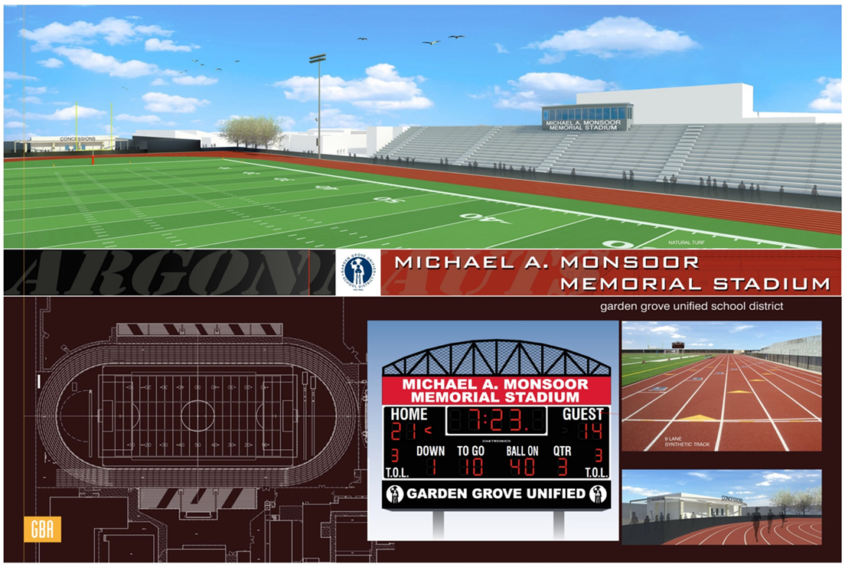
Monsoor Stadium
Garden Grove HS
May 9, 2017

Slide 28
Upcoming Projects
HVAC projects beginning 2017
Hazard ES
Heritage ES
Rosita ES
Wakeham ES
Zeyen ES
May 9, 2017

Slide 29
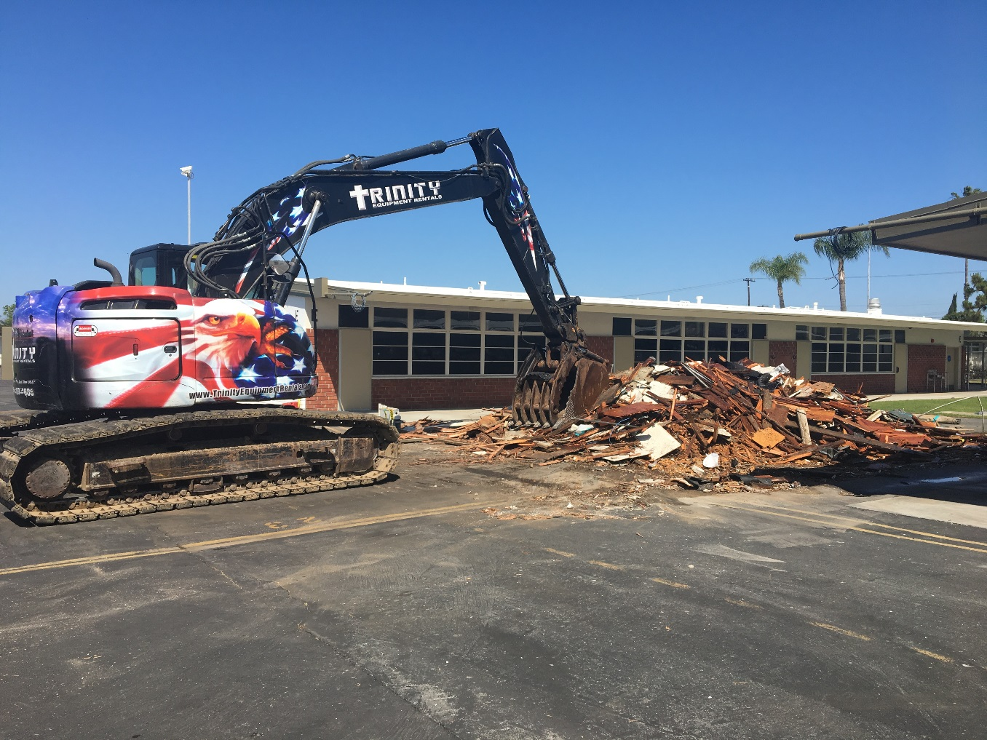
HVAC
Hazard ES
May 9, 2017
Portable Demolition

Slide 30
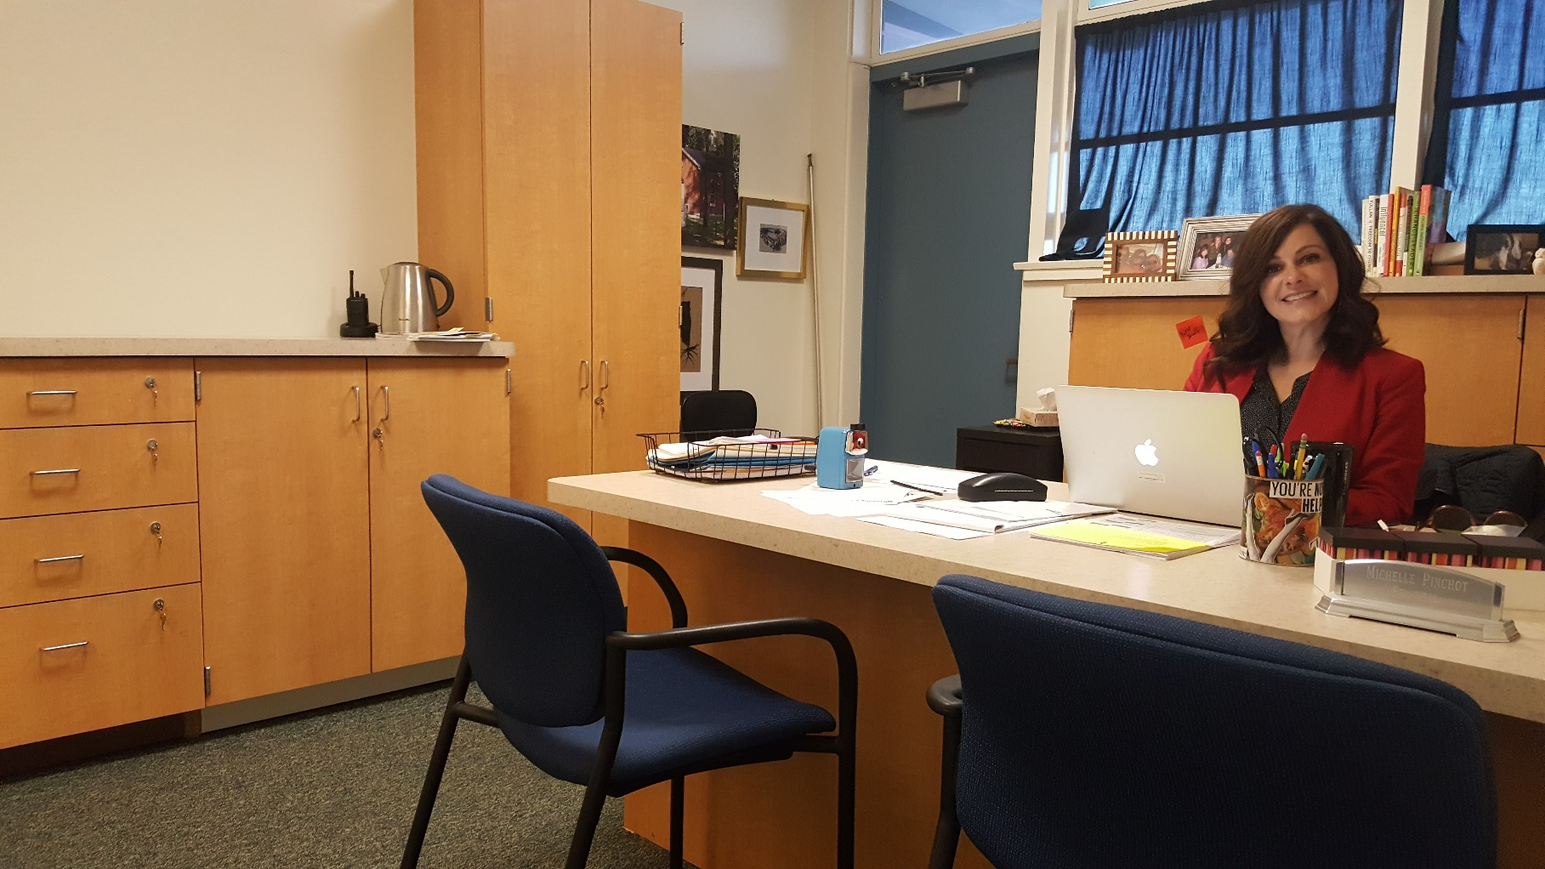
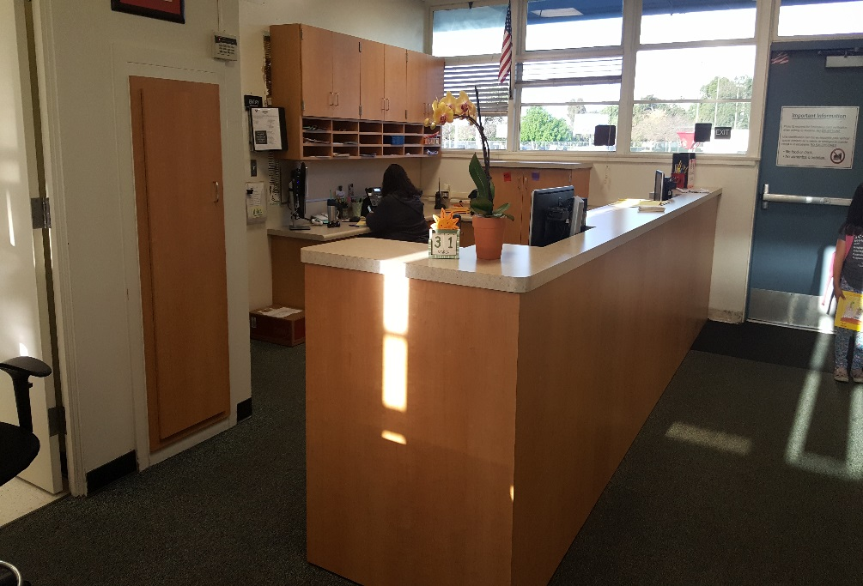
HVAC
Heritage ES
May 9, 2017
New office casework completed early

Slide 31
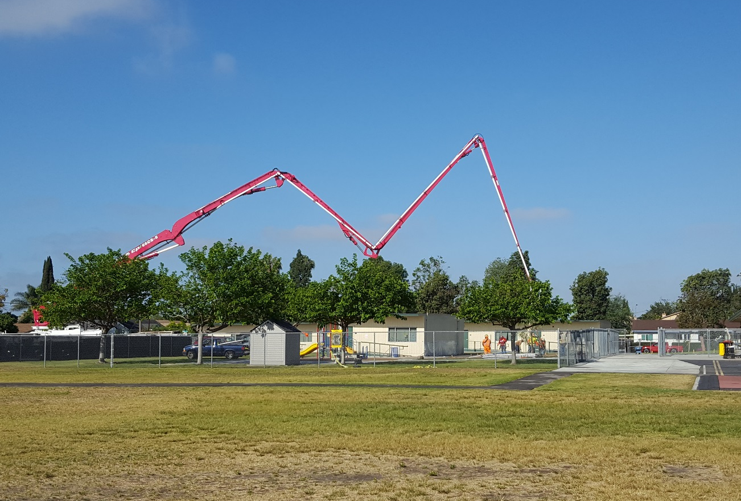
HVAC
Rosita ES
May 9, 2017
Concrete work over spring break

Slide 32
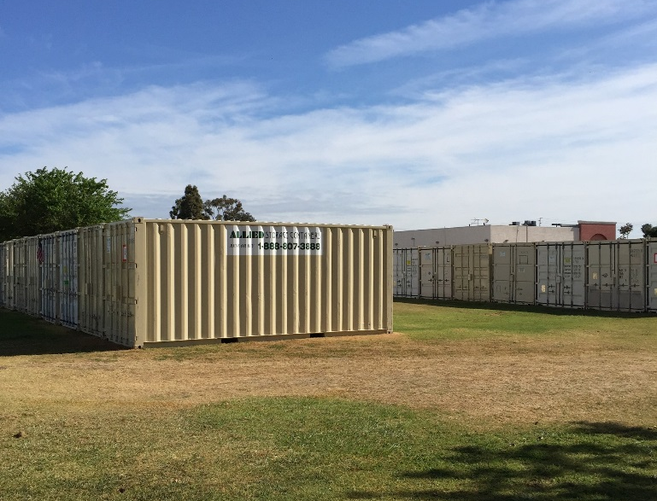
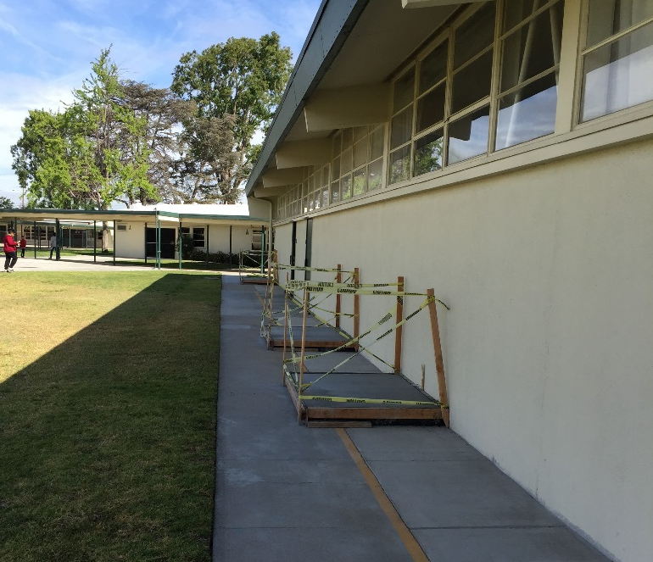
HVAC
Wakeham ES
May 9, 2017
-Storage containers for classroom contents
-Pads for AC condensers

Slide 33
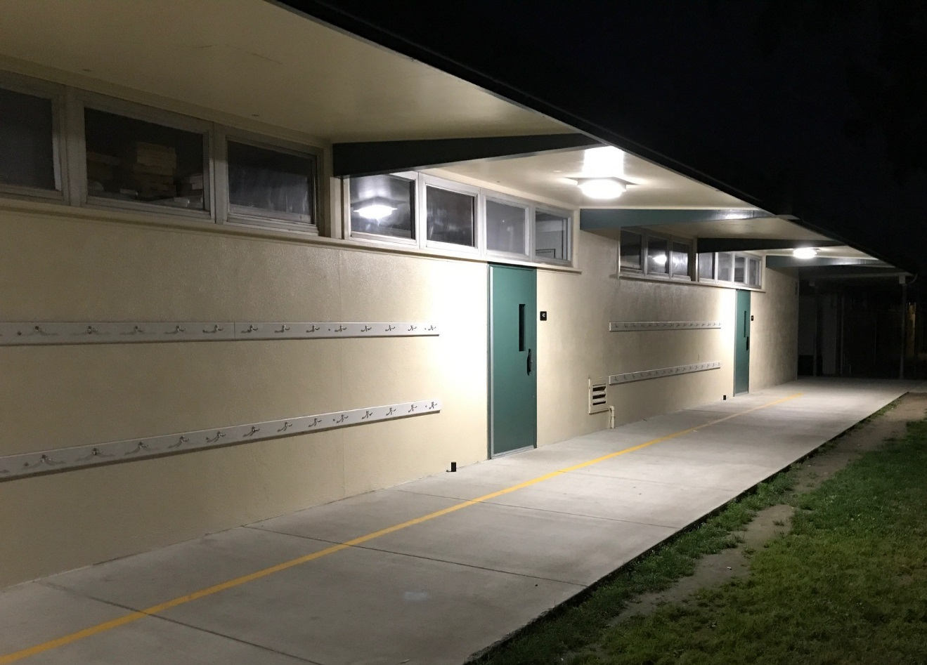
HVAC
Zeyen ES
May 9, 2017
Under eave lighting replaced

Slide 34
Other projects in planning
HVAC projects 2018 and beyond
Bolsa Building R
Bolsa Stadium
Seismic Gym Locker Buildings
May 9, 2017

Slide 35
QUESTIONS

Slide 36
Facilities Update
Thank You!

